Slide 1


Analysis of Monthly Energy Consumption by Customer Type and Zip Code in Nashville TN
By
Peter Busienei
Notes:
In this capstone ...
We define electricity intensity as electricity demand per person or dollar of economic activity. We argue that falling electricity intensity is driven largely by increased energy efficiency. Increases in efficiency across industrial, commercial and household sectors have arrested the growth in electricity consumption.

Slide 2

Facts
Nashville Electric Service(NES) is one of the 12 largest public electric utilities in the nation, distributing energy to more than 400,000 customers in Middle Tennessee.
NES has been in service for 80 years
NES is among the four percent of all public utilities in the country to receive the Reliable Public Power Providers Diamond Award, the industry’s highest honor for offering safe and reliable electricity to customers.
Average price of electricity: 10.65 ¢/kWh
Average monthly usage: 1,238 kWh per customer (2nd highest in the nation)
Average monthly bill: $129 (7th highest)
Notes:
1922 - Nashville's street car company merges into a new entity called the Tennessee Electric Power Co. (TEPCO).
1938 - TEPCO sues the Tennessee Valley Authority for trying to sell power in Nashville.
1939 - TVA wins the lawsuit and buys TEPCO for $79 million. Five-hundred employees of TEPCO become employees of the newly created Nashville Electric Service.
1950 - Construction begins on NES' headquarters at Church Street and 13th Avenue.

Slide 3
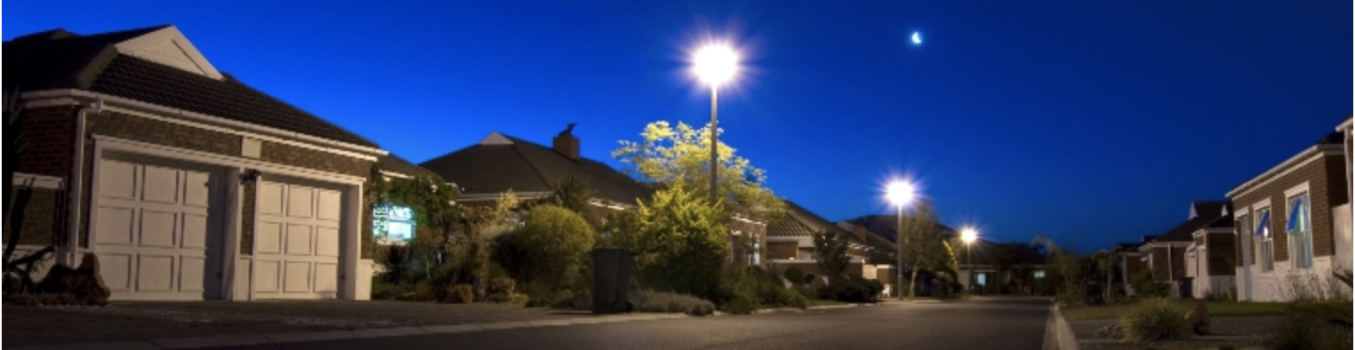
Nashville electric service(NES) customers
Residential: services for individual homes on permanent foundations, that are not part of a park.
Commercial: services to permanent commercial or industrial structures, outbuildings on residential property (barns, shops, pump-houses, garages, etc.), or any three-phase service whether it is for residential or commercial use.
Outdoor Lighting: services for outdoor security lighting to create a safer environment for homes or business. Lights can be installed on existing utility poles or on specially placed poles based on the necessary level of lighting.
Seasonal: Services offered during holidays such as Christmas tree stands, Christmas lights in Lebanon
Notes:
NES will visit your property to design a lighting plan tailored to your needs

Slide 4
Challenges
The ZIP Codes with less than 100 NES customers was not displayed by NES for privacy reasons.
Most Nashville open data has many variables removed to protect the identity of individuals.
The data provided have few variables to consider during analysis, hence the limited scope.
The data does not provide square footage of the residential houses.
There is no different category types of residential houses.
Notes:
It would have been interesting to see residential homes broken into different square footage and how each consumes energy.

Slide 5
Agenda
Classify consumers to different types
Analyze trends and total annual electric consumption
Analyze average annual/monthly energy consumption
Show average annual energy consumption per customer type
Show insights from the data for NES average energy consumption by zip code
The 10 highest and lowest energy consuming zip codes and any key influencers

Slide 6
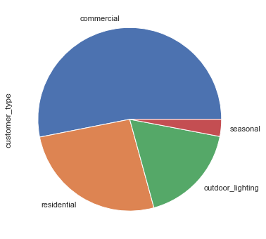
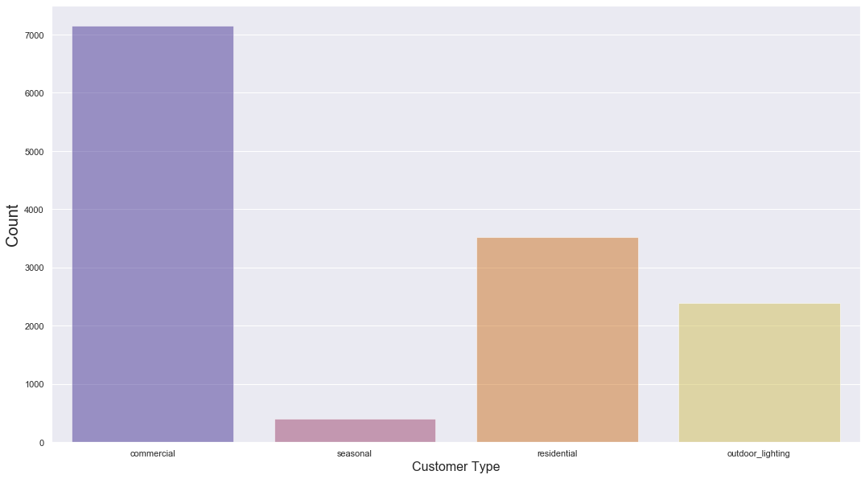
Who’s the highest consumer?
51%
4%
27%
18%

Slide 7
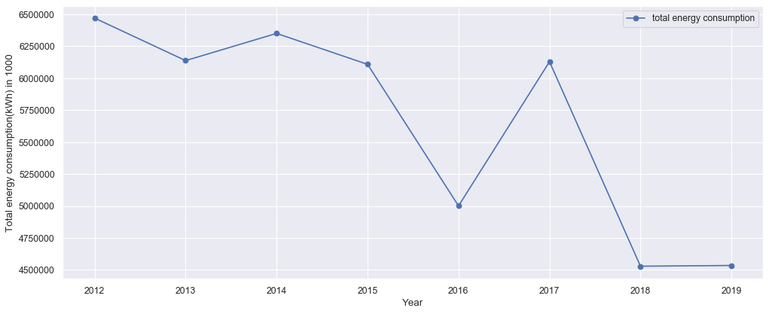
Annual energy consumption
Notes:
Highest year being 2012, there is a decline trend lowest in 2019 as per the updated dataset on December 20, 2019

Slide 8
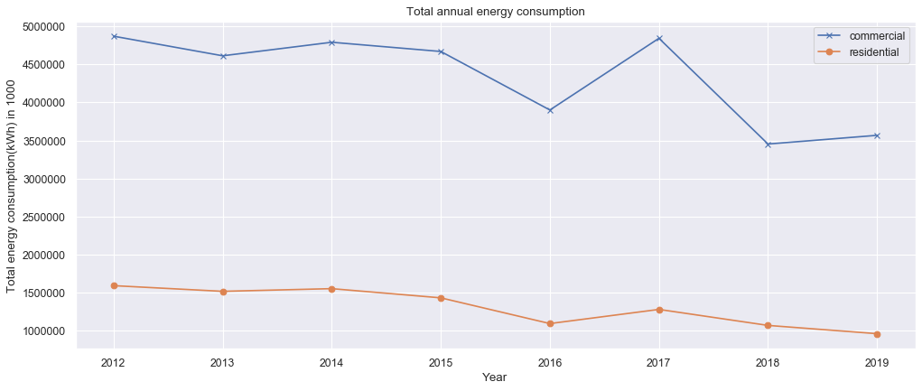
Annual Energy consumption by commercial and residential customer
Notes:
Highest year being 2012, there is a decline trend lowest in 2019 as per the updated dataset on December 20, 2019

Slide 9
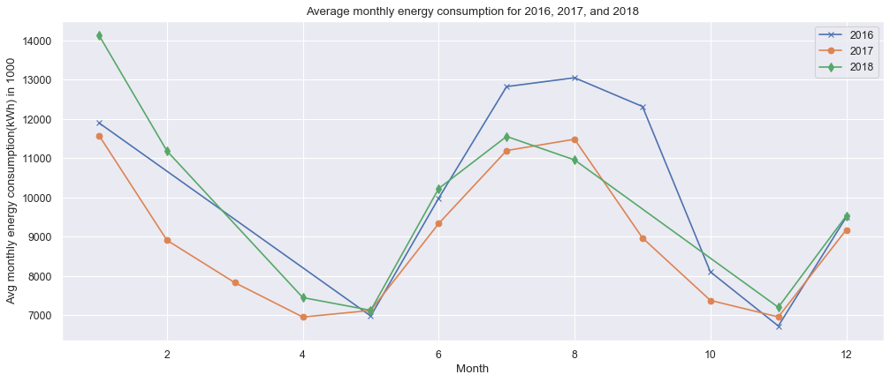
Year 2016,2017 or 2018 an outlier?
Notes:
Highest year being 2012, there is a decline trend lowest in 2019 as per the updated dataset on December 20, 2019

Slide 10
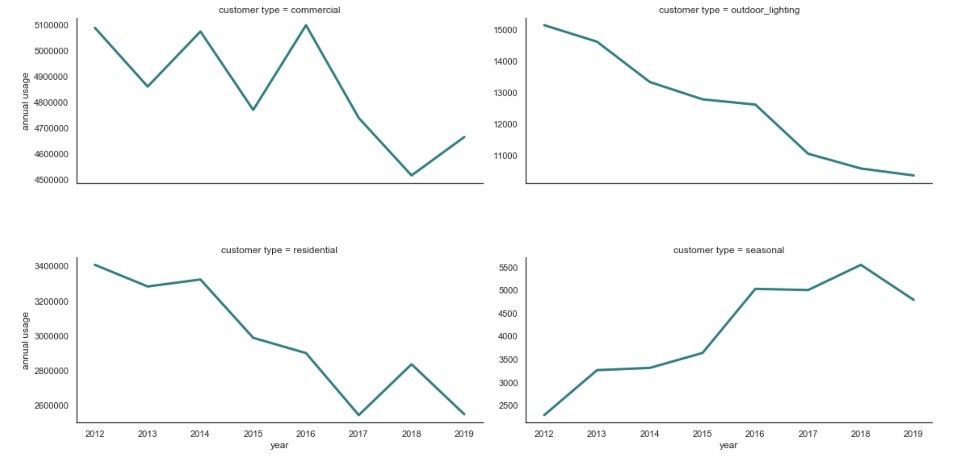
Avg annual energy consumption by customer type

Slide 11
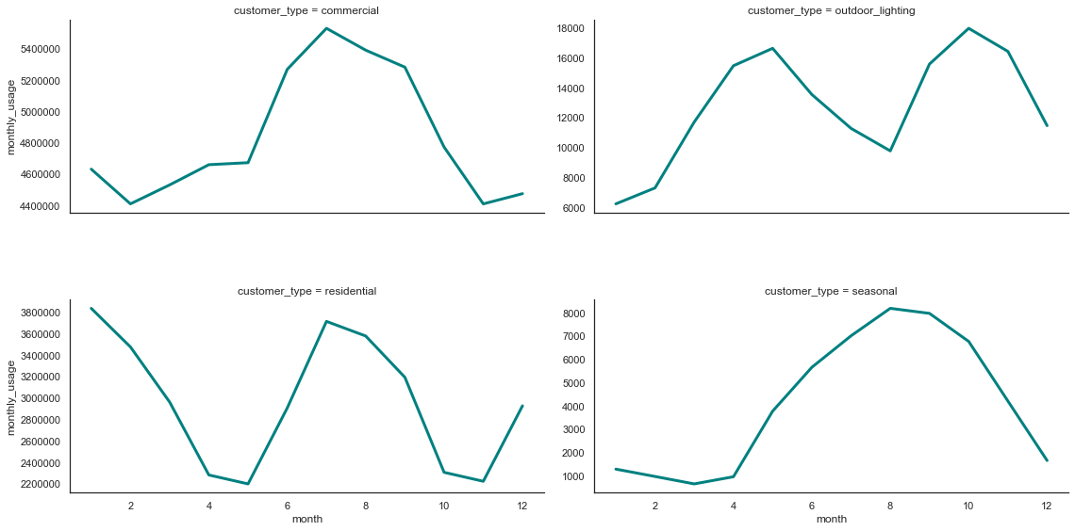
Avg monthly energy consumption by customer type

Slide 12
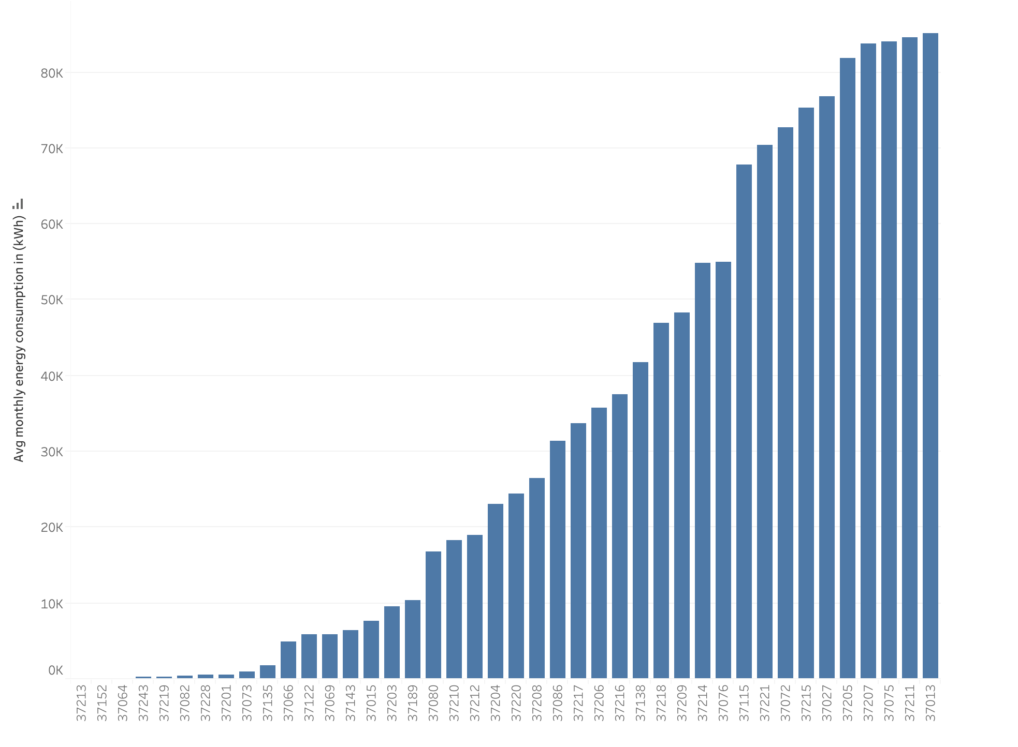
Avg monthly energy consumption per zip code
Zip code
Notes:
Average annual electricity consumption for a U.S. residential utility customer was 10,972 kilowatthours (kWh), an average of about 914 kWh per month. Tennessee had the highest annual electricity consumption at 15,394 kWh per residential customer as per U.S. Energy information administration.

Slide 13
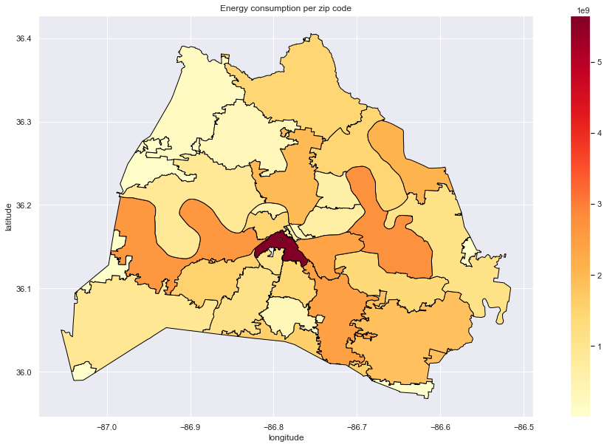
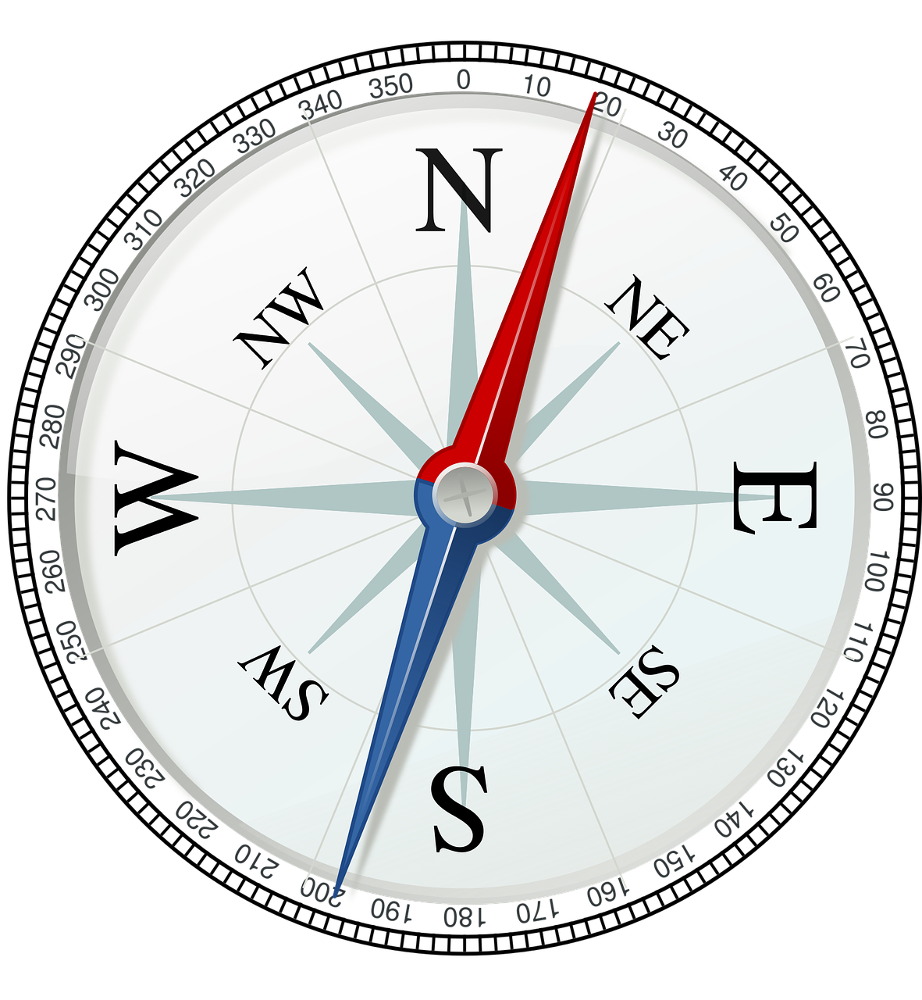
Total energy consumption per zip code
NSS
Notes:
What’s happening in 37203?

Slide 14
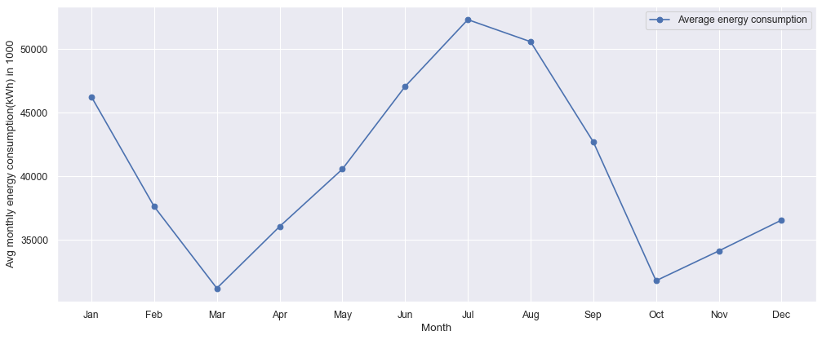
Residential customer avg monthly energy consumption (kWh)
Notes:
Decline in average energy consumption

Slide 15
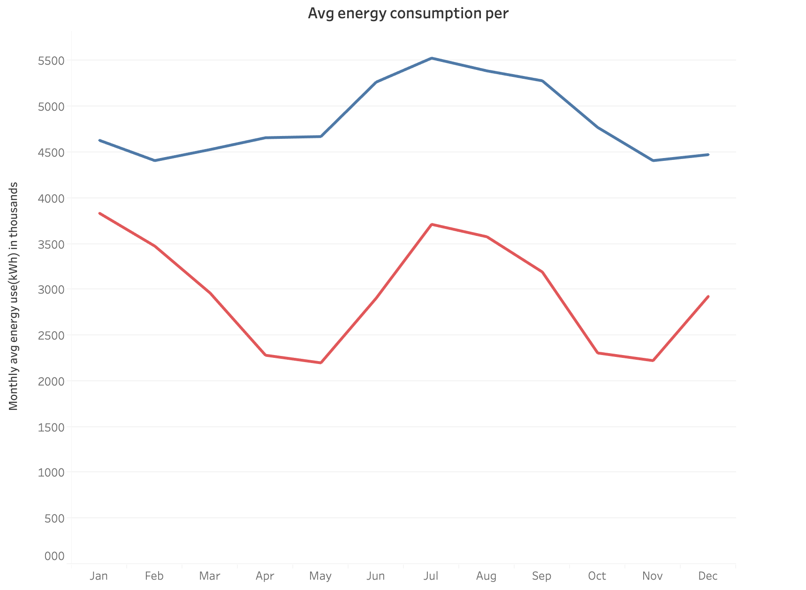
avg monthly energy consumption (kWh)
Commercial customer
Residential customer
month
Notes:
Decline in average energy consumption

Slide 16
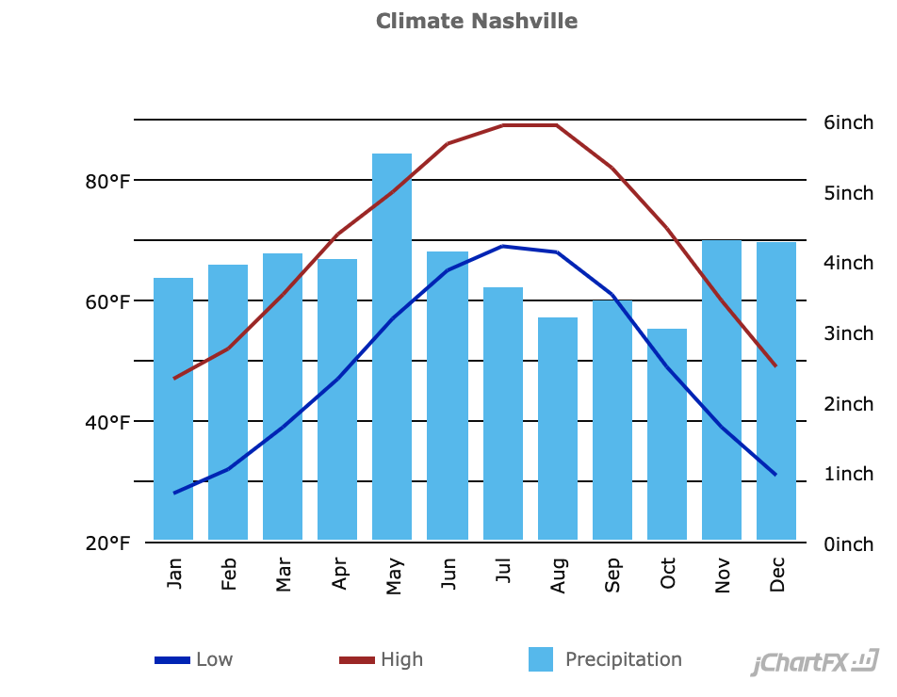
Nashville weather?
Notes:
Decline in average energy consumption

Slide 17



Any key influencers of residential ZIP Code energy consumption?
Population
Median income
Median age
Unemployment
Median home price
Notes:
Decline in average energy consumption

Slide 18
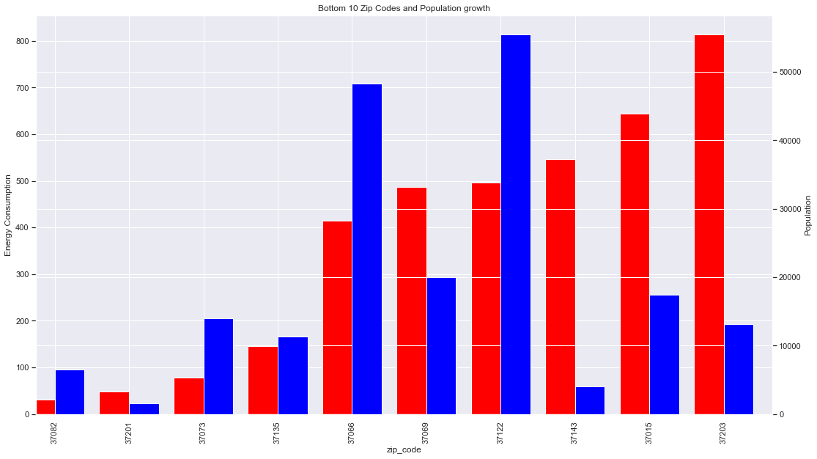
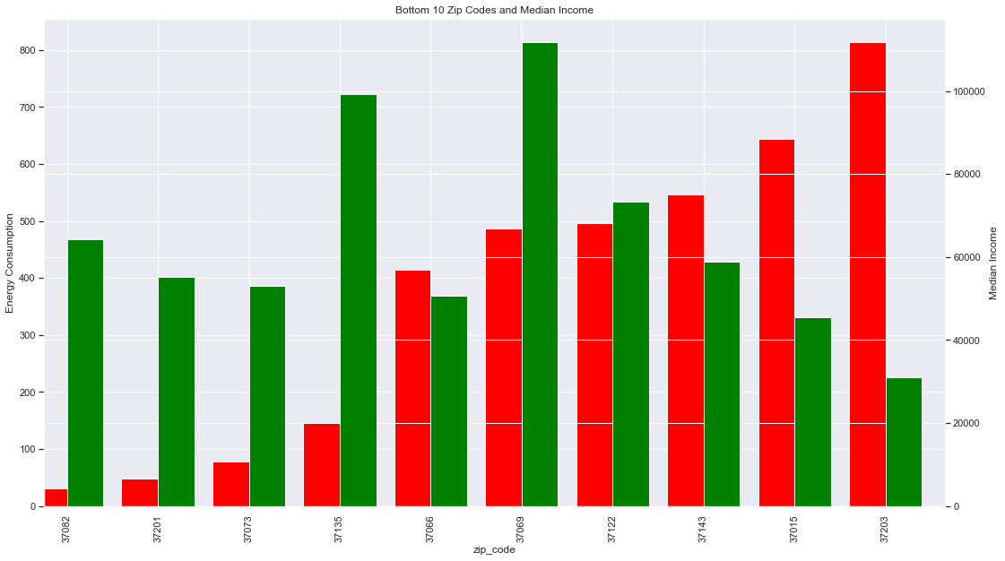
Population growth and median income?
Notes:
Decline in average energy consumption

Slide 19
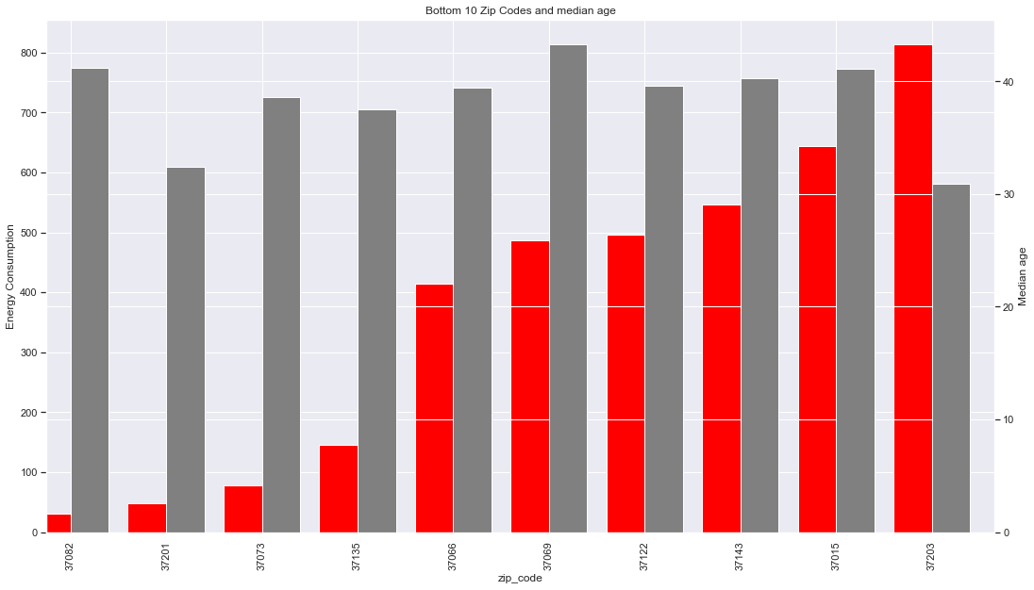
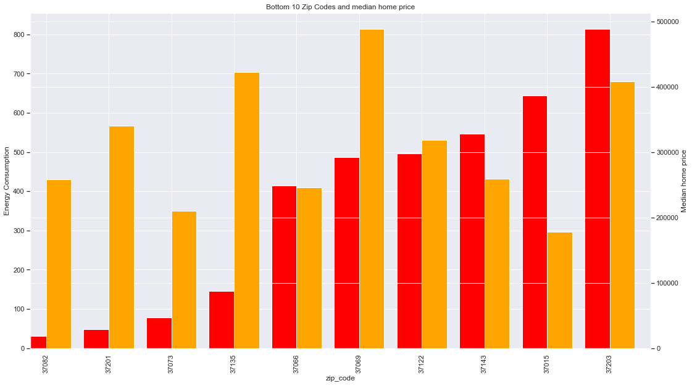
Median age and median home price?
Notes:
Decline in average energy consumption

Slide 20
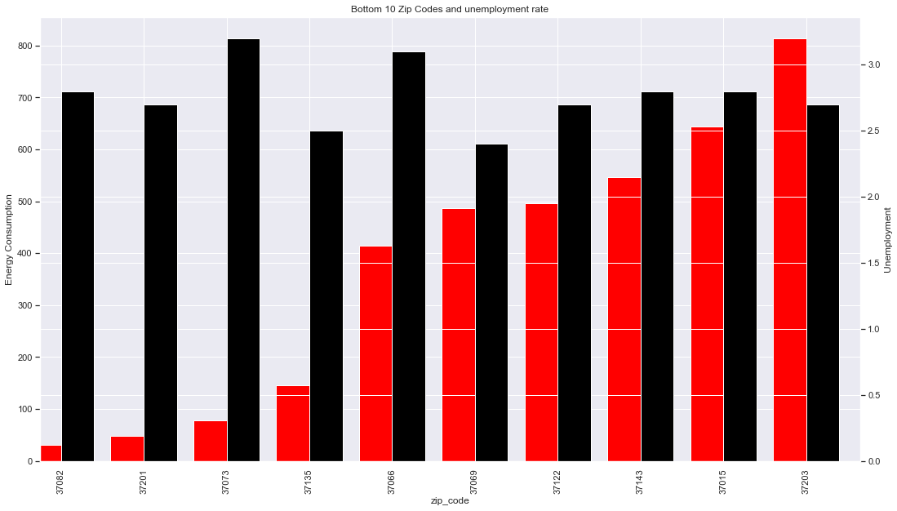
Unemployment?
Notes:
Decline in average energy consumption

Slide 21
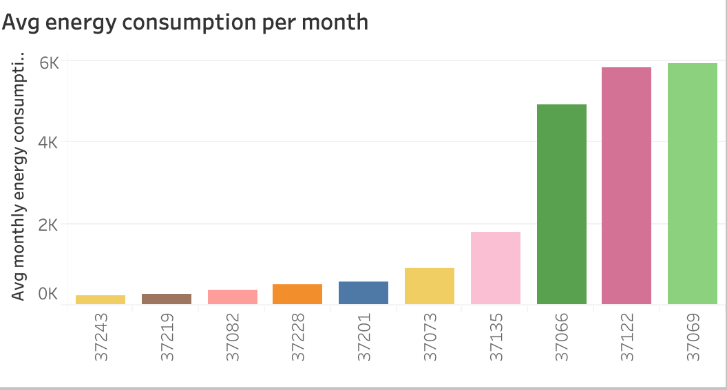
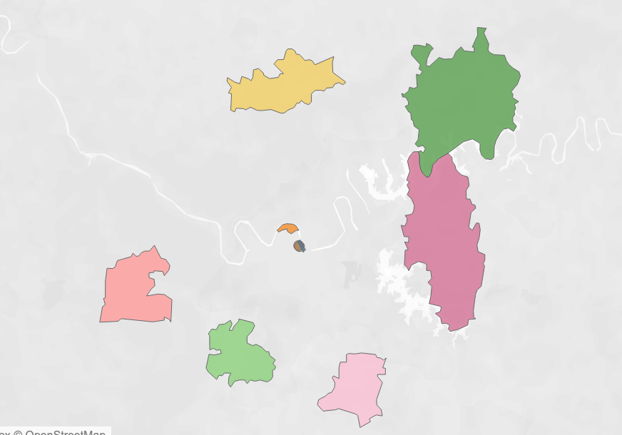
Is there relationship with proximity for bottom 10?

Slide 22
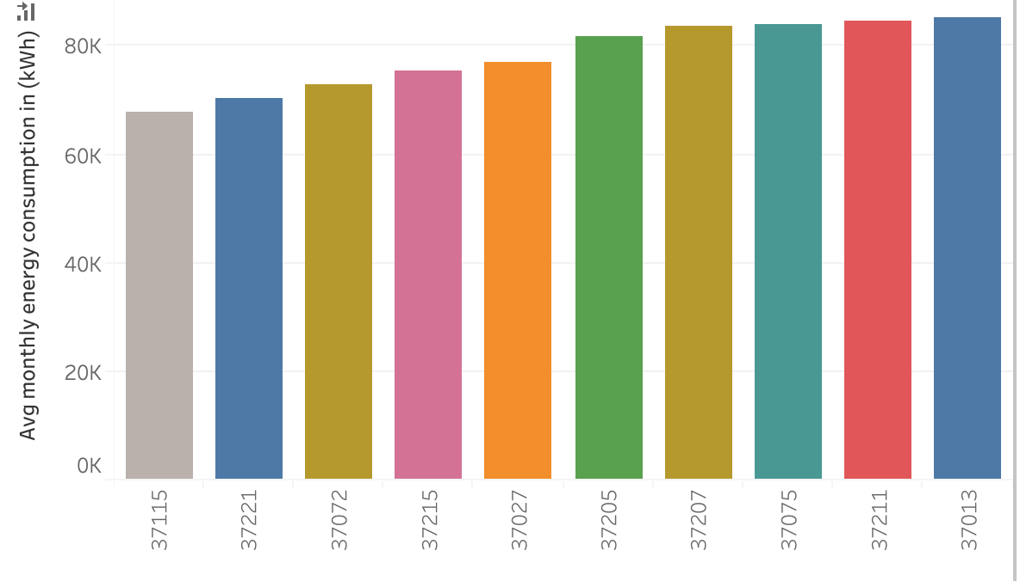
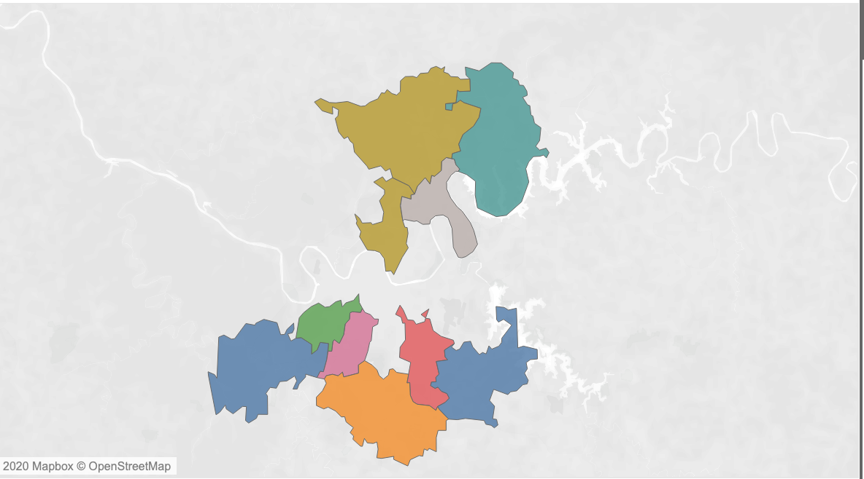
Top 10 energy consuming zip codes
37221
37013

Slide 23
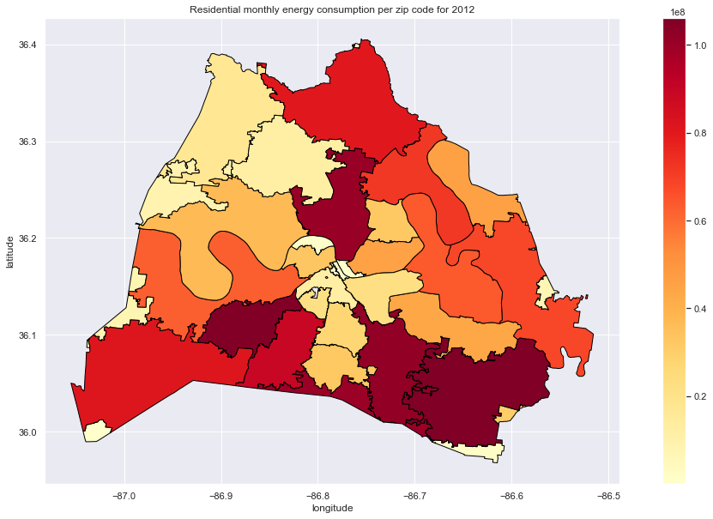
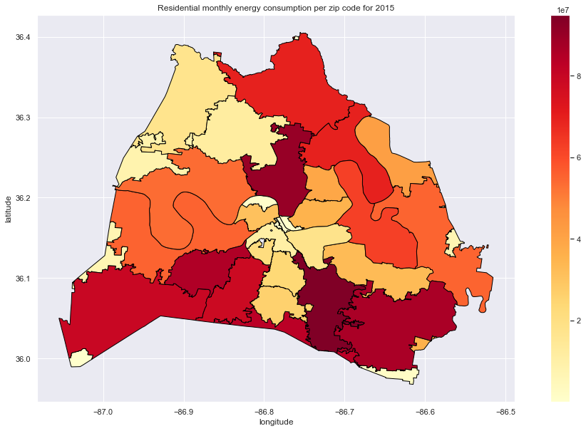
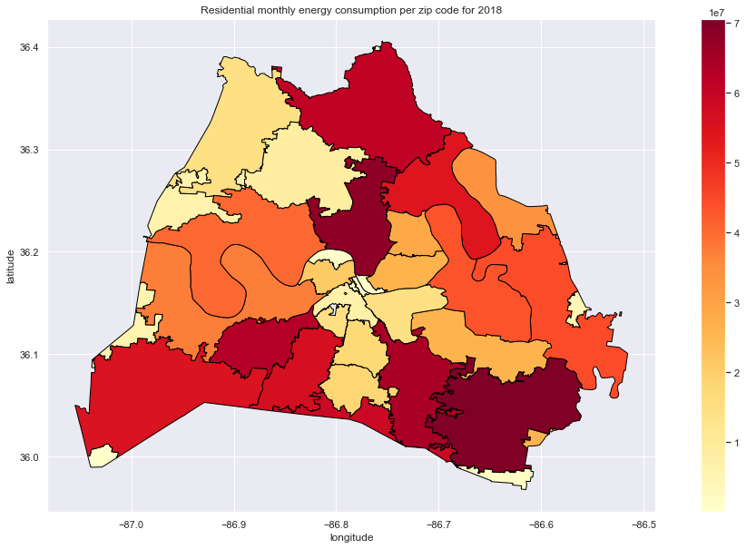
How is energy distribution over the years?

Slide 24
Recommendations
Further analysis need to be done on the age of the homes
Know the different home electric equipment’s in a zip code
The different sizes of residence

Slide 25
References
Data.Nashville.gov (https://data.nashville.gov/Energy-Usage/NES-Monthly-Energy-Consumption-by-Customer-Type-an/vbx7-mn5i)
U.S. Energy Information administration( https://www.eia.gov/)
United States zip codes(https://www.unitedstateszipcodes.org/)
Choose energy (https://www.chooseenergy.com/news/article/the-states-that-use-the-most-and-least-amount-of-energy-per-household/)
Statistica (https://www.statista.com/statistics/807951/average-monthly-electricity-usage-in-major-us-cities/)
Nashville Electric Service https://www.nespower.com

Slide 26
Tableau viz
https://public.tableau.com/profile/bush1897#!/vizhome/EnergyConsumption_15781937576950/Mydashboard?publish=yes

Slide 27
Thank You!

Slide 28
Appendix

Slide 29
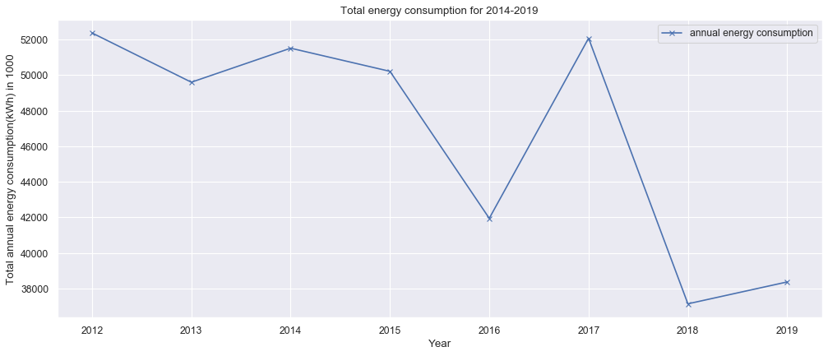
Total Energy consumption in Nashville (2012-2019)
Notes:
Highest year being 2012, there is a decline trend lowest in 2019 as per the updated dataset on December 20, 2019

Slide 30
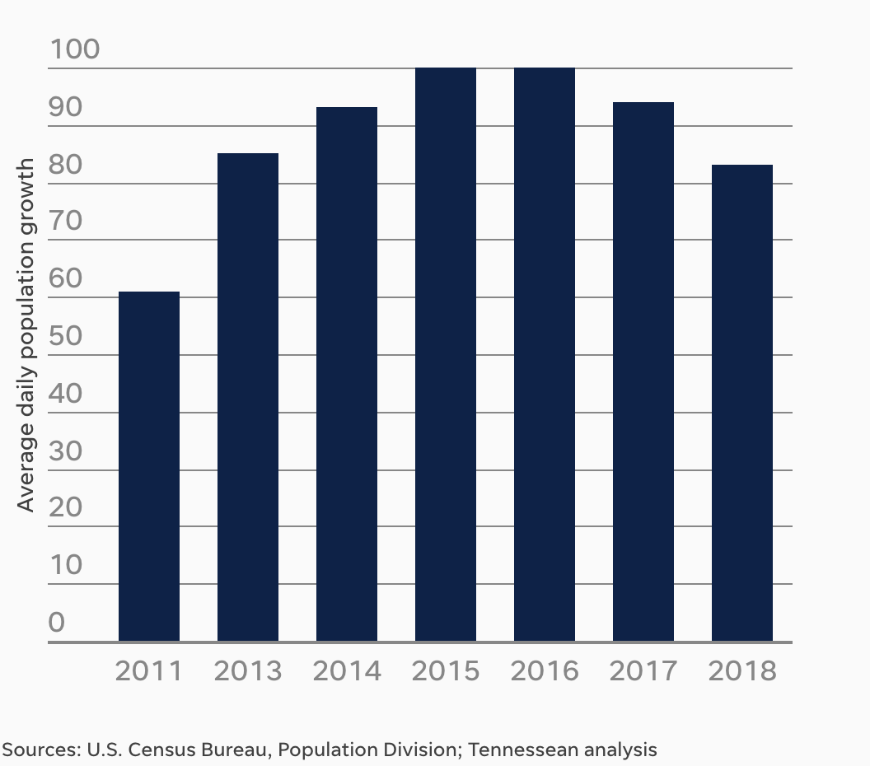
Nashville daily avg population growth

Slide 31
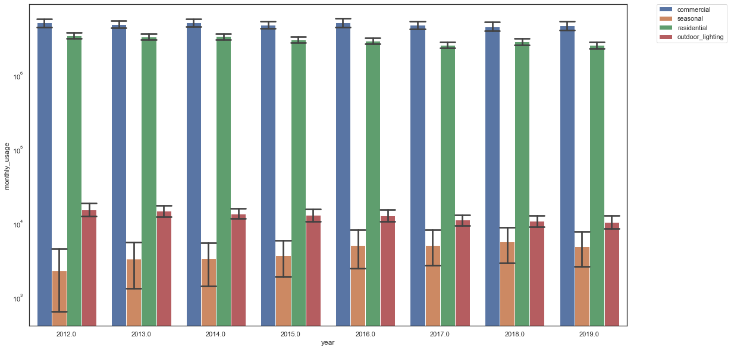
Energy consumption trends over the years
Notes:
SD error bars

Slide 32
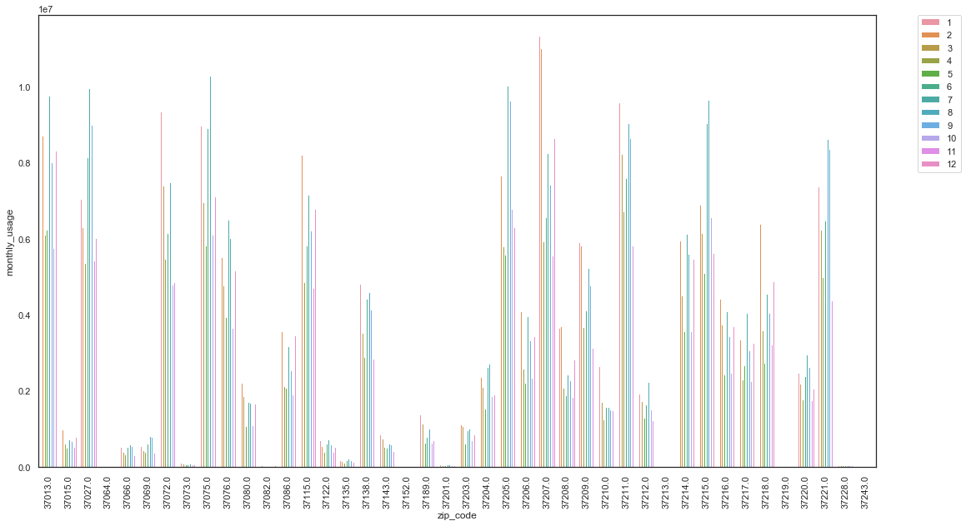
Residential monthly energy consumption
Notes:
Line plot could be better
Annual avg of each zip code

Slide 33
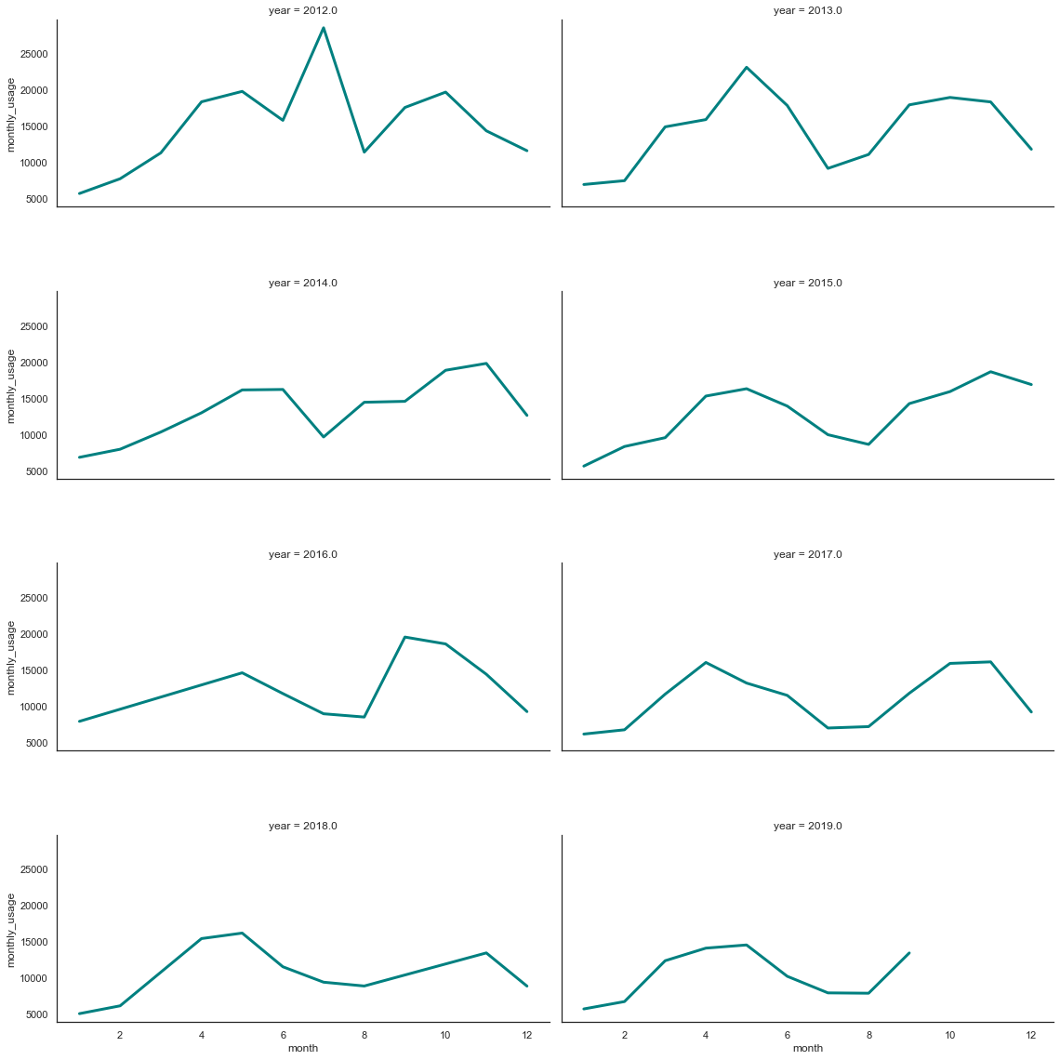
Monthly energy consumption per year ermonth

Slide 34
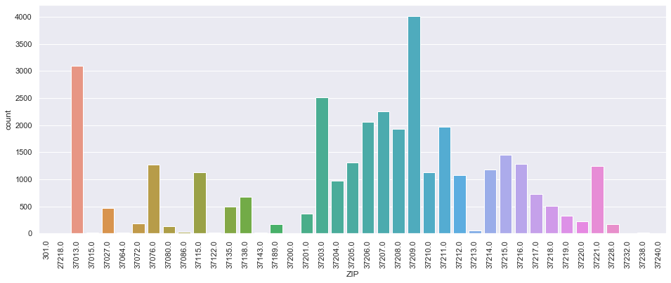
Total building permits issued
Notes:
Permits issued between 2015

Slide 35
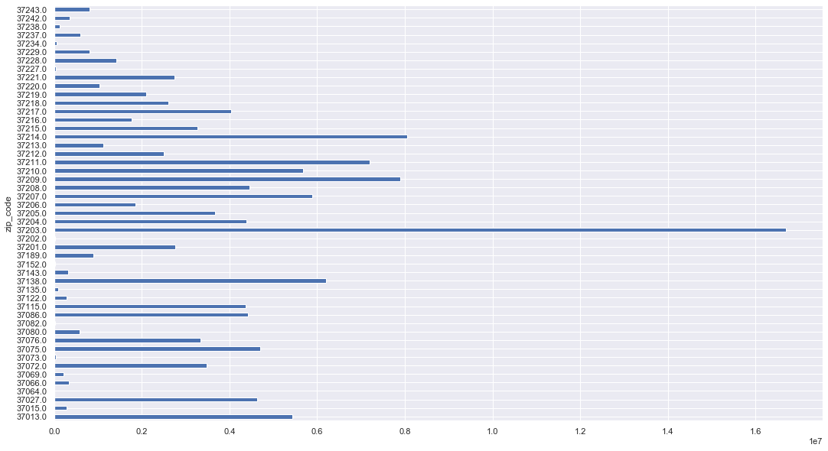
Total energy consumption per zip code

Slide 36
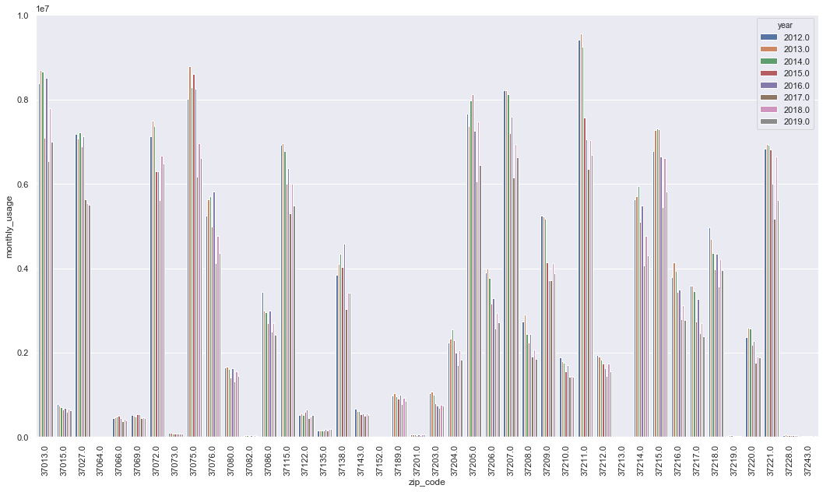
Residential annual energy consumption per zip code
Notes:
2012/2018 comparison graph
Average annual electricity consumption for a U.S. residential utility customer was 10,972 kilowatthours (kWh), an average of about 914 kWh per month. Tennessee had the highest annual electricity consumption at 15,394 kWh per residential customer as per U.S. Energy information administration.

Slide 37
